Slide 1
Module-1
Operating Systems with Linux Internals-CSE3120
Introduction to OS
Prepared By…
Shankar Rana
Asst. Prof., CSE, PU
1

Slide 2
Contents Module 1: Introduction [9 Hrs.] [Knowledge Level (1)]
Introduction to OS – Computer System Architecture, Operating System Structure, Operations – Different management activities handled by the OS, Computing environments, Operating System Services, User and OS interface, System Calls and its types, System Programs[ loaders, linkers...],
Overview of OS design and implementation.
Linux Operating System: Introduction to Linux OS, Basic Commands of Linux OS
Operating Systems
2

Slide 3
What is an Operating System?
A program that acts as an intermediary between a user of a computer and the computer hardware
Operating system goals:
Execute user programs and solving user problems easily
Make the computer system convenient to use
Use of computer hardware in an efficient manner

Slide 4
Computer System Structure
Computer system can be divided into four components:
Hardware – provides basic computing resources
CPU, memory, I/O devices
Operating system
Controls and coordinates use of hardware among various applications and users
Application programs – define the ways in which the system resources are used to solve the computing problems of the users
Word processors, compilers, web browsers, database systems, video games
Users
People, machines, other computers

Slide 5
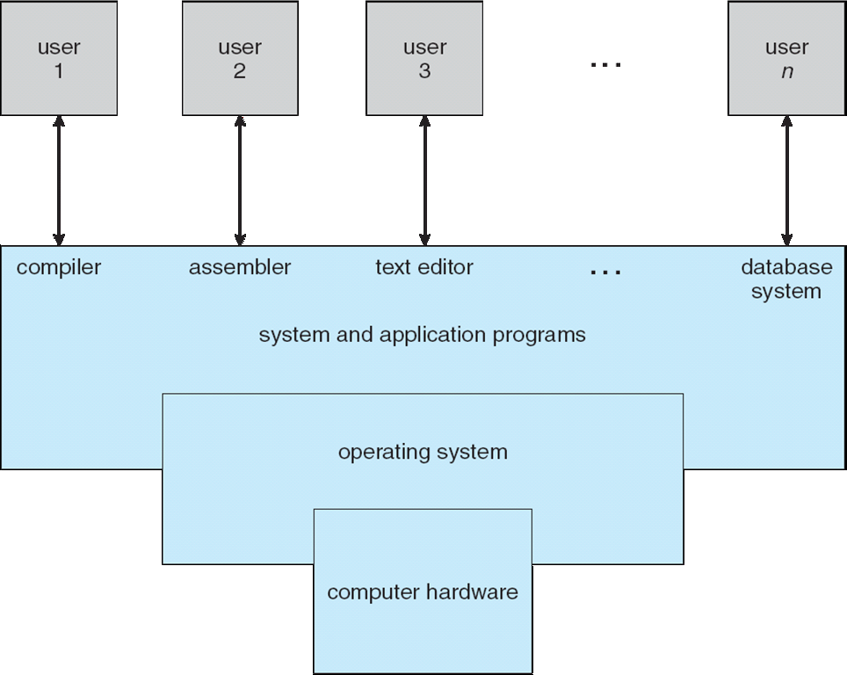
Four Components of a Computer System

Slide 6
What Operating Systems Do
Depends on the point of view
Users want convenience- ease of use and good performance
Don’t care about resource utilization
But shared computer such as mainframe or minicomputer must keep all users happy
Users of dedicated systems such as workstations have dedicated resources but frequently use shared resources from servers
Handheld computers are resource poor, optimized for usability and battery life
Some computers have little or no user interface, such as embedded computers in devices and automobiles

Slide 7
Operating System Definition
OS is a resource allocator
Manages all resources
Decides between conflicting requests for efficient and fair resource use
OS is a control program
Controls execution of programs to prevent errors and improper use of the computer

Slide 8
Operating System Definition (Cont.)
No universally accepted definition
“Everything a vendor ships when you order an operating system” is a good approximation
But varies wildly
“The one program running at all times on the computer” is the kernel
Everything else is either
a system program (ships with the operating system) , or
an application program

Slide 9
Computer Startup
bootstrap program is loaded at power-up or reboot
Typically stored in ROM or EPROM, generally known as firmware
Initializes all aspects of system
Loads operating system kernel and starts execution

Slide 10
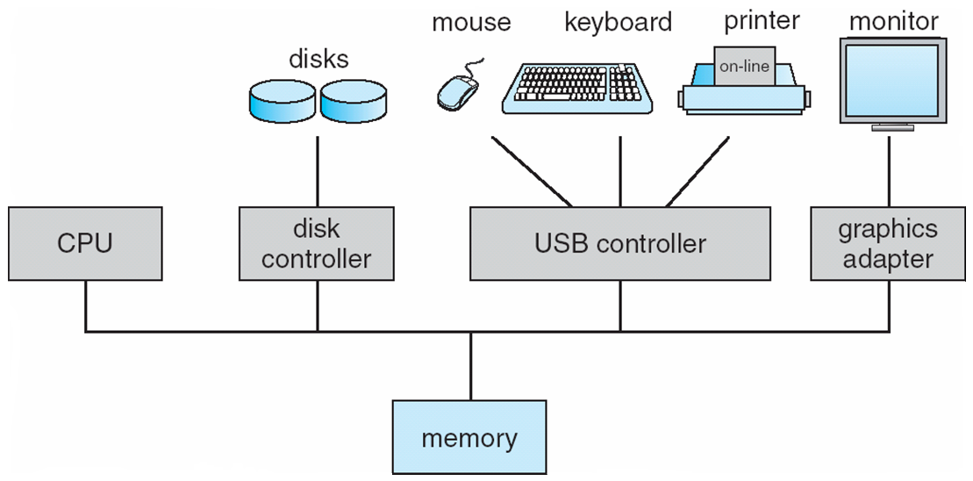
Computer System Organization
Computer-system operation
One or more CPUs, device controllers connect through common bus providing access to shared memory
Concurrent execution of CPUs and devices competing for memory cycles

Slide 11
Computer-System Operation
I/O devices and the CPU can execute concurrently
Each device controller is in-charge of a particular device type
Each device controller has a local buffer
CPU moves data from/to main memory to/from local buffers
I/O is from the device to local buffer of controller
Device controller informs CPU that it has finished its operation by causing an Interrupt

Slide 12
Storage Structure
Main memory – only large storage media that the CPU can access directly
Random access
Typically volatile
Secondary storage – extension of main memory that provides large nonvolatile storage capacity
Hard disks – rigid metal or glass platters covered with magnetic recording material
Disk surface is logically divided into tracks, which are subdivided into sectors
The disk controller determines the logical interaction between the device and the computer
Solid-state disks – faster than hard disks, nonvolatile
Various technologies
Becoming more popular

Slide 13
Storage Hierarchy
Storage systems organized in hierarchy
Speed
Cost
Volatility
Caching – copying information into faster storage system;
main memory can be viewed as a cache for secondary storage
Device Driver for each device controller to manage I/O
Provides uniform interface between controller and kernel

Slide 14
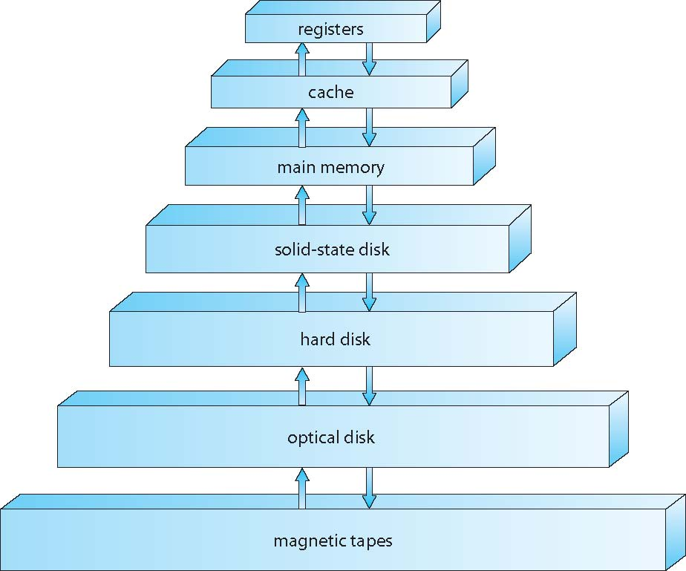
Storage-Device Hierarchy

Slide 15
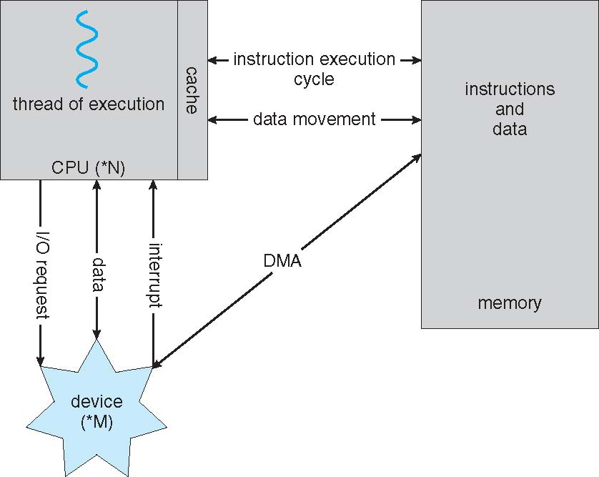
How a Modern Computer Works
A von Neumann architecture

Slide 16
Computer-System Architecture
Single General-Purpose processor- Mostly used systems
Most systems have special-purpose processors as well-
limited instruction set and do not run user processes
2. Multiprocessors systems- growing in use and importance
Also known as parallel systems, tightly-coupled systems
Advantages include:
Increased throughput
Economy of scale
Increased reliability – graceful degradation or fault tolerance
Two types:
Asymmetric Multiprocessing – each processor is assigned a specific task.
Symmetric Multiprocessing – each processor performs all tasks

Slide 17
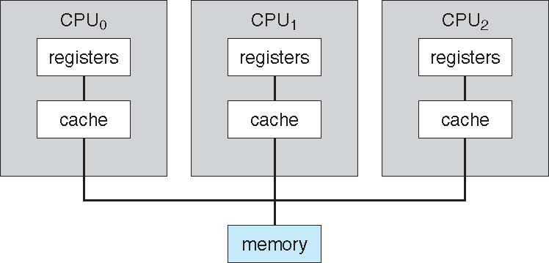
Symmetric Multiprocessing Architecture
boss processor controls the system; the other processors either look to the boss for instruction or have predefined tasks
boss processor schedules and allocates work to the worker processors

Slide 18
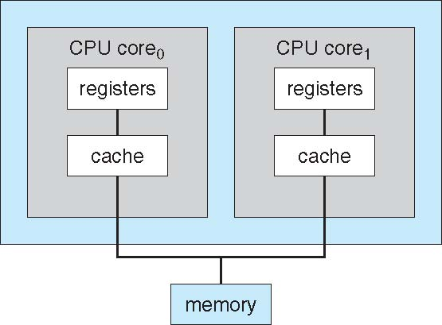
Dual-Core Design
Multi-chip and multicore
Systems containing all chips
Chassis containing multiple separate systems
each core has its own register set as well as its own local cache

Slide 19
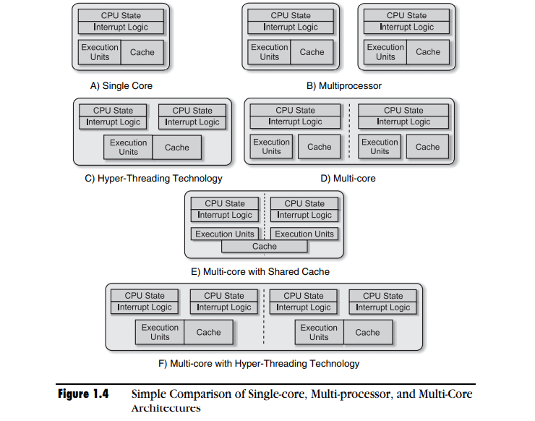

Slide 20
Clustered Systems
Like multiprocessor systems, but multiple systems working together
composed of two or more individual systems—or nodes—joined together (loosely coupled)
Usually sharing storage via a storage-area network (SAN)
Provides a high-availability service which survives failures
Asymmetric clustering has one machine in hot-standby mode
Symmetric clustering has multiple nodes running applications, monitoring each other- more efficient
Some clusters are for high-performance computing (HPC)
Applications must be written to use parallelization
Some have distributed lock manager (DLM) to avoid conflicting operations

Slide 21
Clustered Systems

Slide 22
Operating System Structure
Multiprogramming (Batch system) needed for efficiency
Single user cannot keep CPU and I/O devices busy at all times
Multiprogramming organizes jobs (code and data) so CPU always has one to execute
A subset of total jobs in system is kept in memory
One job selected and run via job scheduling
When it has to wait (for I/O for example), OS switches to another job
Timesharing (multitasking): logical extension of Multiprogramming
CPU switches jobs so frequently that users can interact with each job while it is running, creating interactive computing
Response time should be < 1 second
Each user has at least one program executing in memory process
If several jobs ready to run at the same time  CPU scheduling
If processes don’t fit in memory, swapping moves them in and out to run
Virtual memory allows execution of processes not completely in memory

Slide 23
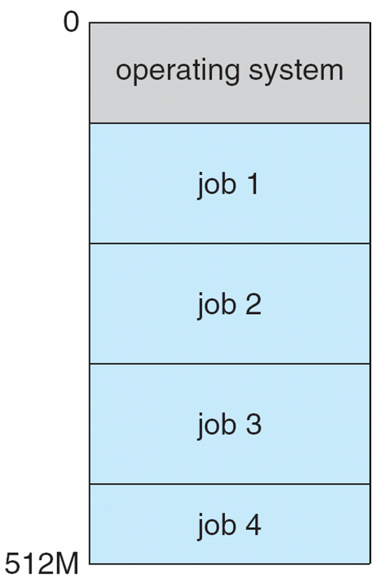
Memory Layout for Multiprogrammed System

Slide 24
Operating-System Operations
Modern operating systems are Interrupt driven (hardware and software)
Hardware interrupt by one of the devices
Software interrupt (exception or trap):
Software error (e.g., division by zero)
Request for operating system service
Other process problems include infinite loop, processes modifying each other or the operating system

Slide 25








User Applications
Figure gives an insight into the basic components of an operating system and their interfaces with rest of the world
Application Programming Interface (API)
Memory Management
Kernel Services
Process Management
Time Management
File System Management
I/O System Management
Device Driver Interface
Underlying Hardware

Slide 26
Operating-System Operations (cont.)
Dual-mode operation allows OS to protect itself and other system components
User mode and kernel mode
Mode bit provided by hardware
Provides ability to distinguish when system is running user code or kernel code
Some instructions designated as privileged, only executable in kernel mode
System call changes mode to kernel, return from call resets it to user
Increasingly CPUs support multi-mode operations
i.e. virtual machine manager (VMM) mode for guest VMs

Slide 27
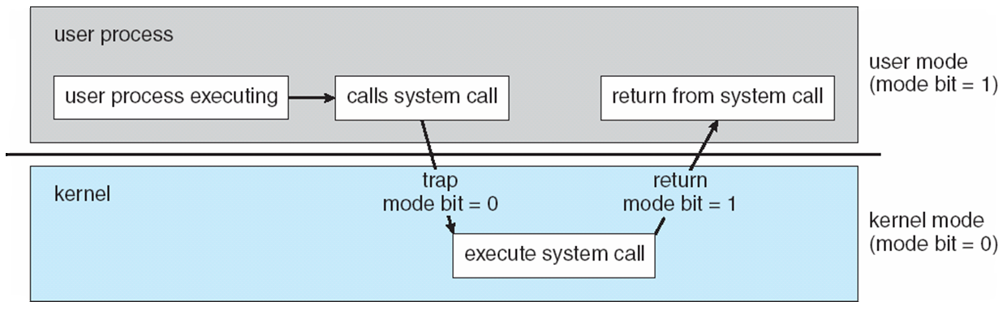
Transition from User to Kernel Mode
Timer- to prevent infinite loop / process hogging resources
Timer is set to interrupt the computer after some time period
Keep a counter that is decremented by the physical clock.
Operating system set the counter (privileged instruction)
When counter zero generate an interrupt

Slide 28
Process Management
A process is a program in execution
It is a unit of work within the system.
Program is a passive entity, process is an active entity.
Process needs resources to accomplish its task
CPU, memory, I/O, files
Initialization data
Process termination requires reclaim of any reusable resources

Slide 29
Process Management contd…
Single-threaded process has one program counter specifying location of next instruction to execute
Process executes instructions sequentially, one at a time, until completion
Multi-threaded process has one program counter per thread
Typically system has many processes, some user, some operating system running concurrently on one or more CPUs
Concurrency by multiplexing the CPUs among the processes / threads

Slide 30
Process Management Activities
OS is responsible for the following activities in connection with process management:
Creating and deleting both user and system processes
Suspending and resuming processes
Providing mechanisms for process synchronization
Providing mechanisms for process communication
Providing mechanisms for deadlock handling

Slide 31
Memory Management
To execute a program all (or part) of the instructions must be in memory
All (or part) of the data that is needed by the program must be in memory.
Memory management determines what is in memory and when
Optimizing CPU utilization and computer response to users
Keeping track of which parts of memory are currently being used and by whom
Deciding which processes (or parts thereof) and data to move into and out of memory
Allocating and deallocating memory space as needed
Memory management activities

Slide 32
Storage Management
OS provides uniform, logical view of information storage
Abstracts physical properties to logical storage unit - file
File- Collection of related information defined by its creator
The operating system maps files onto physical media and accesses these files via the storage devices
File-System management
Files usually organized into directories
Access control on most systems to determine who can access what
OS activities include
Creating and deleting files and directories
Primitives to manipulate files and directories
Mapping files onto secondary storage
Backup files onto stable (non-volatile) storage media

Slide 33
Mass-Storage Management
Usually disks used to store data that does not fit in main memory or data that must be kept for a “long” period of time
Proper management is of central importance
Entire speed of computer operation hinges on disk subsystem and its algorithms
Some storage need not be fast
Tertiary storage includes optical storage, magnetic tape
Still must be managed – by OS or applications
Varies between WORM (write-once, read-many-times) and RW (read-write)
OS activities
Free-space management
Storage allocation
Disk scheduling

Slide 34
Performance of Various Levels of Storage
Movement between levels of storage hierarchy can be explicit or implicit

Slide 35
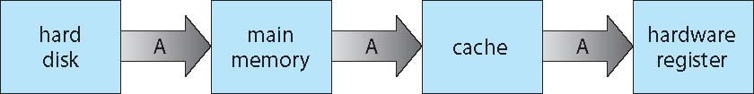
Migration of data “A” from Disk to Register
Multitasking environments must be careful to use most recent value, no matter where it is stored in the storage hierarchy Multiprocessor environment must provide cache coherency in hardware such that all CPUs have the most recent value in their cache
Distributed environment situation even more complex

Slide 36
I/O Subsystem
One purpose of OS is to hide peculiarities of hardware devices from the user
I/O subsystem responsible for
Memory management of I/O including buffering, caching, spooling (the overlapping of output of one job with input of other jobs)
General device-driver interface
Drivers for specific hardware devices

Slide 37
Protection and Security
Protection – mechanism for controlling access of processes or users to resources defined by the OS
Security – defense of the system against internal and external attacks
Huge range, including denial-of-service, worms, viruses, identity theft, theft of service
Systems generally first distinguish among users, to determine who can do what
User identities (user IDs, security IDs) include name and associated number, one per user
User ID then associated with all files, processes of that user to determine access control
Group identifier (group ID) allows set of users to be defined and controls managed, then also associated with each process, file
Privilege escalation allows user to change to effective ID with more rights

Slide 38
Computing Environments
- Traditional
Stand-alone general purpose machines
But blurred as most systems interconnect with others (i.e., the Internet)
Portals provide web access to internal systems
Network computers (thin clients) are like Web terminals
Mobile computers interconnect via wireless networks
Networking becoming ubiquitous – even home systems use firewalls to protect home computers from Internet attacks

Slide 39
Computing Environments – Mobile
Handheld smartphones, tablets, etc
What is the functional difference between them and a “traditional” laptop?
Extra feature – more OS features (GPS, Gyroscope)
Allows new types of apps like augmented reality
Use IEEE 802.11 wireless, or cellular data networks for connectivity
Leaders are Apple iOS and Google Android

Slide 40
Computing Environments – Distributed
Distributed computing
Collection of separate, possibly heterogeneous, systems networked together
Network is a communications path, TCP/IP most common
Local Area Network (LAN)
Wide Area Network (WAN)
Metropolitan Area Network (MAN)
Personal Area Network (PAN)
Network Operating System provides features between systems across network
Communication scheme allows systems to exchange messages
Illusion of a single system

Slide 41
Computing Environments - Client-Server
Client-Server Computing
Dumb terminals supplanted by smart PCs
Many systems now servers, responding to requests generated by clients
Compute-server system provides an interface to client to request services (i.e., database)
File-server system provides interface for clients to store and retrieve files

Slide 42
Computing Environments – Peer-to-Peer
Another model of distributed system
P2P does not distinguish clients and servers
All nodes are considered peers
May each act as client, server or both
Node must join P2P network
Registers its service with central lookup service on network, or
Broadcast request for service and respond to requests for service via discovery protocol
Examples include Napster and Gnutella, Voice over IP (VoIP) such as Skype

Slide 43
Computing Environments – Virtualization
Allows operating systems to run applications within other OSes
Vast and growing industry
Emulation used when source CPU type is different from target type (i.e. PowerPC to Intel x86)
Generally slowest method
When computer language not compiled to native code – Interpretation
Virtualization – OS natively compiled for CPU, running guest OSes also natively compiled
Consider VMware running WinXP guests, each running applications, all on native WinXP host OS
VMM (virtual machine Manager) provides virtualization services

Slide 44
Computing Environments - Virtualization

Slide 45
Computing Environments – Cloud Computing
Delivers computing, storage, even apps as a service across a network
Logical extension of virtualization
Many types
Public cloud – available via Internet to anyone willing to pay
Private cloud – run by a company for the company’s own use
Hybrid cloud – includes both public and private cloud components
Software as a Service (SaaS) – one or more applications available via the Internet (i.e., word processor)
Platform as a Service (PaaS) – software stack ready for application use via the Internet (i.e., a database server)
Infrastructure as a Service (IaaS) – servers or storage available over Internet (i.e., storage available for backup use)}

Slide 46
Cloud Computing Contd..
Cloud computing environments composed of traditional OSes, plus VMMs, plus cloud management tools
Internet connectivity requires security like firewalls
Load balancers spread traffic across multiple applications

Slide 47
Computing Environments – Real-Time Embedded Systems
Real-time embedded systems most prevalent form of computers
Vary considerable, special purpose, limited purpose OS, real-time OS
Usages are expanding
Many other special computing environments as well
Some have OSes, some perform tasks without an OS
Real-time OS has well-defined fixed time constraints
Processing must be done within constraint
Correct operation only if constraints met

Slide 48
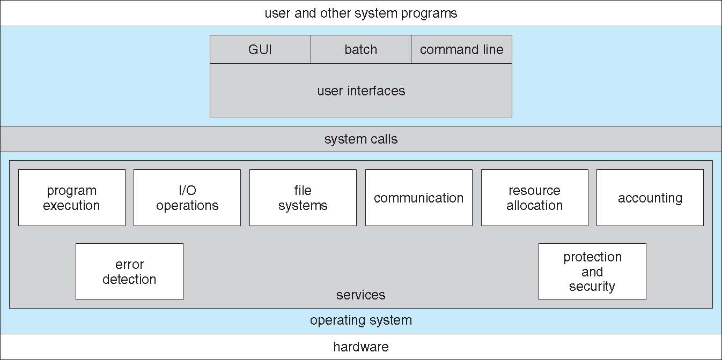
A View of Operating System Services

Slide 49
System Calls
Programming interface to the services provided by the OS
Typically written in a high-level language (C or C++)
Mostly accessed by programs via a high-level Application Programming Interface (API) rather than direct system call use
Three most common APIs are
Win32 API for Windows,
POSIX API for POSIX-based systems
Java API for the Java virtual machine (JVM)

Slide 50
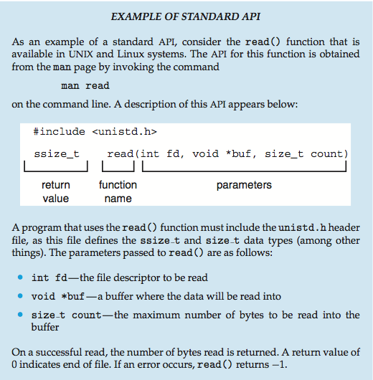
Example of Standard API

Slide 51
System Call Implementation
Typically, a number associated with each system call
System-call interface maintains a table indexed according to these numbers
The system call interface invokes the intended system call in OS kernel and returns status of the system call and any return values
The caller need know nothing about how the system call is implemented
Just needs to obey API and understand what OS will do as a result call
Most details of OS interface hidden from programmer by API
Managed by run-time support library (set of functions built into libraries included with compiler)

Slide 52
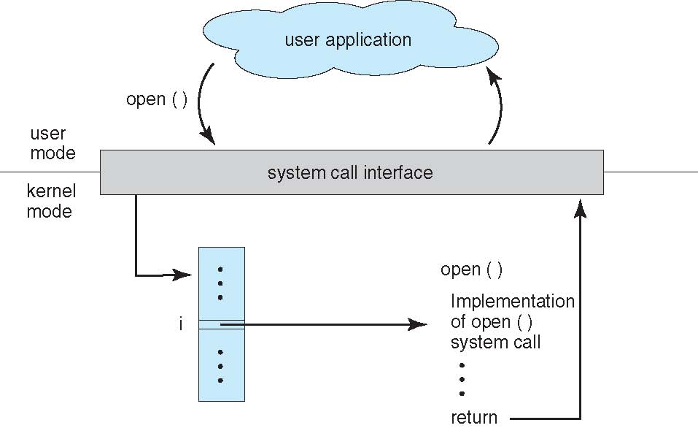
API – System Call – OS Relationship

Slide 53
Types of System Calls
Process control
create process, terminate process
end, abort
load, execute
get process attributes, set process attributes
wait for time
wait event, signal event
allocate and free memory
Dump memory if error
Debugger for determining bugs, single step execution
Locks for managing access to shared data between processes

Slide 54
File management
create file, delete file
open, close file
read, write, reposition
get and set file attributes
Device management
request device, release device
read, write, reposition
get device attributes, set device attributes
logically attach or detach devices

Slide 55
Information maintenance
get time or date, set time or date
get system data, set system data
get and set process, file, or device attributes
Communications
create, delete communication connection
send, receive messages if message passing model to host name or process name
From client to server
Shared-memory model create and gain access to memory regions
transfer status information
attach and detach remote devices

Slide 56
Protection
Control access to resources
Get and set permissions
Allow and deny user access

Slide 57
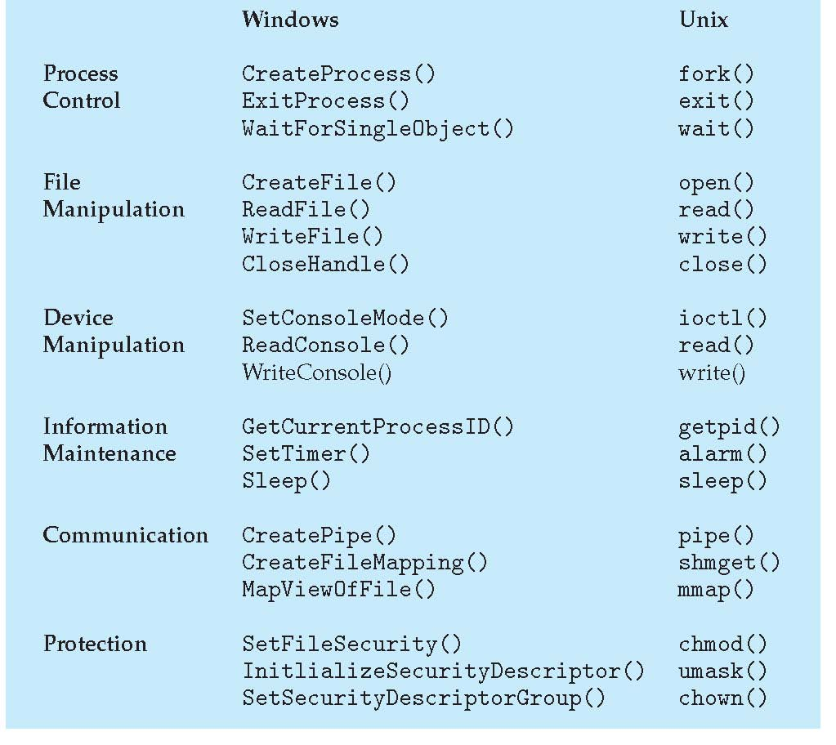
Examples of Windows and Unix System Calls

Slide 58
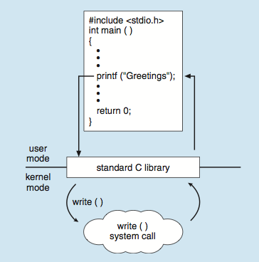
Standard C Library Example
C program invoking printf() library call, which calls write() system call

Slide 59
Operating System Structure
General-purpose OS is very large program
Various ways to structure ones
Simple structure – MS-DOS
More complex -- UNIX
Layered – an abstrcation
Microkernel -Mach

Slide 60
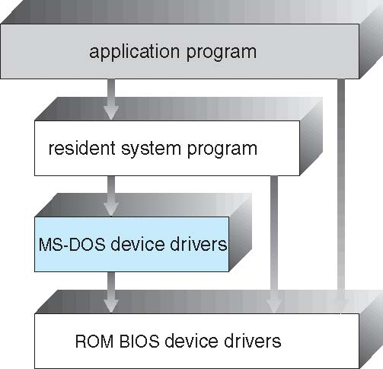
Simple Structure -- MS-DOS
MS-DOS – written to provide the most functionality in the least space
Not divided into modules
Although MS-DOS has some structure, its interfaces and levels of functionality are not well separated

Slide 61
Non Simple Structure -- UNIX
UNIX – limited by hardware functionality, the original UNIX operating system had limited structuring.
The UNIX OS consists of two separable parts
Systems programs
The kernel
Consists of everything below the system-call interface and above the physical hardware
Provides the file system, CPU scheduling, memory management, and other operating-system functions; a large number of functions for one level

Slide 62
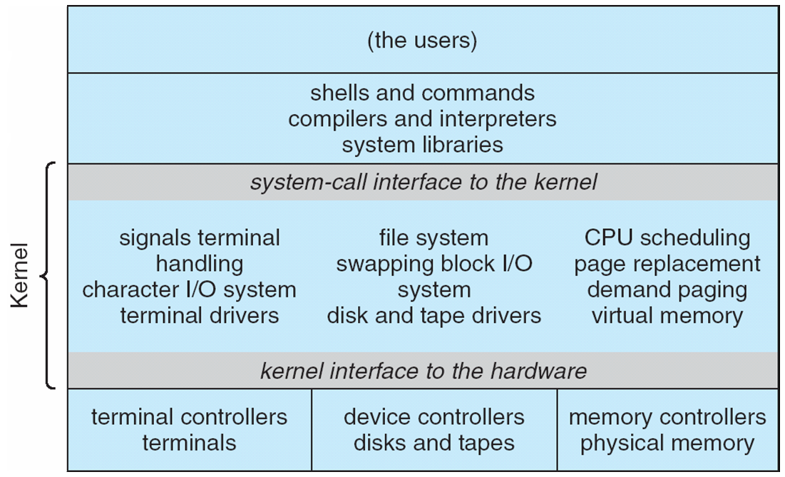
Traditional UNIX System Structure
Beyond simple but not fully layered

Slide 63
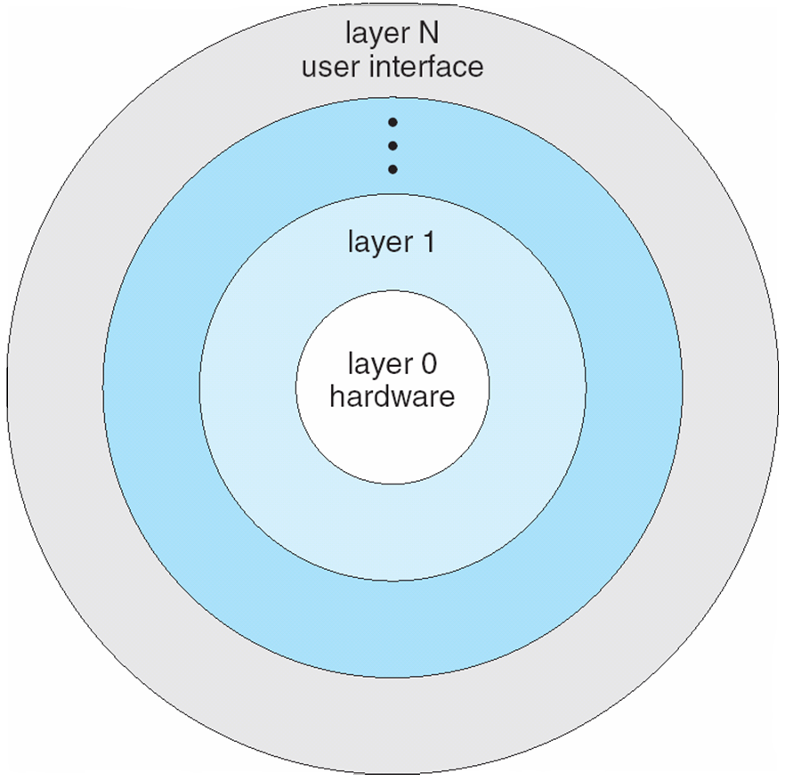
Layered Approach
The operating system is divided into a number of layers (levels), each built on top of lower layers.
The bottom layer (layer 0), is the hardware; the highest (layer N) is the user interface
With modularity, layers are selected such that each uses functions (operations) and services of only lower-level layers

Slide 64
Microkernel System Structure
Moves as much as from the kernel into user space
Mach example of microkernel
Mac OS X kernel (Darwin) partly based on Mach
Communication takes place between user modules using message passing
Benefits:
Easier to extend a microkernel
Easier to port the operating system to new architectures
More reliable (less code is running in kernel mode)
More secure
Detriments:
Performance overhead of user space to kernel space communication

Slide 65
Microkernel System Structure

Slide 66
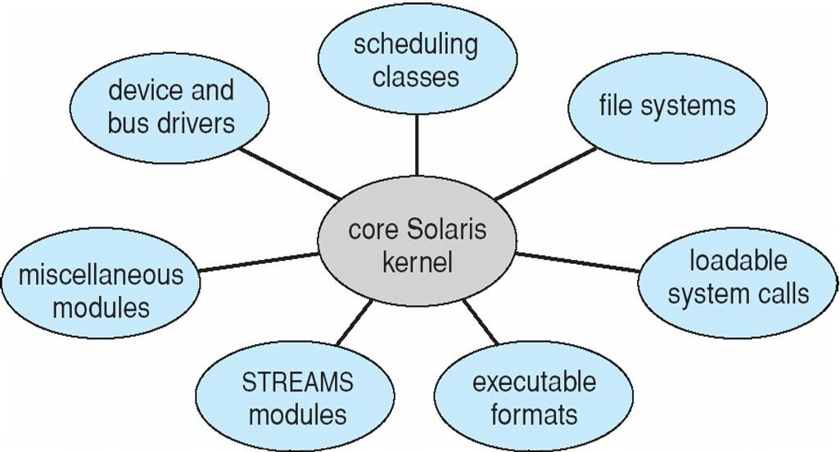
Solaris Modular Approach

Slide 67
iOS
Apple mobile OS for iPhone, iPad
Structured on Mac OS X, added functionality
Does not run OS X applications natively
Also runs on different CPU architecture (ARM vs. Intel)
Cocoa Touch Objective-C API for developing apps
Media services layer for graphics, audio, video
Core services provides cloud computing, databases
Core operating system, based on Mac OS X kernel

Slide 68
Android
Developed by Open Handset Alliance (mostly Google)
Open Source
Similar stack to iOS
Based on Linux kernel but modified
Provides process, memory, device-driver management
Adds power management
Runtime environment includes core set of libraries and Dalvik virtual machine
Apps developed in Java plus Android API
Java class files compiled to Java bytecode then translated to executable than runs in Dalvik VM
Libraries include frameworks for web browser (webkit), database
(SQLite), multimedia, smaller libc

Slide 69
Android Architecture

Slide 70
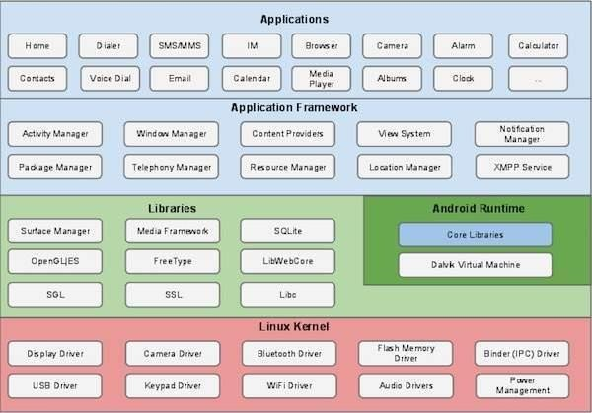

Slide 71
System Programs[ loaders, linkers...],
System programs are
software programs to manage the computer's resources and provide services to other software programs or users.
System programs are an essential part of an operating system and include a wide range of utilities
managing files,
allocating memory,
scheduling tasks, and
providing security
Loaders and linkers are two important types of system programs that are responsible for loading and linking programs into memory for execution.

Slide 72
System Programs[ loaders, linkers...]
Loaders:
Loaders are programs that load executable files into memory for execution.
When a user wants to run a program, the loader reads the program's executable file and transfers it from the storage device into memory.

Slide 73
Linkers:
Linkers are programs that link object files together to create an executable file.
Object files are produced by the compiler and contain the compiled code for a single module of the program.
Linkers take these object files and combine them into a single executable file.

Slide 74
Compiler:
software program that translates human-readable source code written in a high-level programming language into machine-readable code (object code) that a computer executes
compiling involves several stages, including lexical analysis, syntax analysis, semantic analysis, code generation, and optimization.
Compilers are also used to create libraries, operating systems, and other software systems.
Some examples of popular compilers include GCC, Clang, Microsoft Visual C++, and Java Compiler.

Slide 75
Introduction to Linux OS
Linux is a free and open-source operating system (OS) based on the Unix operating system. It was created in 1991 by Linus Torvalds,
widely used in a variety of applications, from servers to desktops to embedded systems.
One of the key features of Linux is its modularity and flexibility.
Linux kernel is the core of the operating system,
and it can be customized and configured in many different ways to meet the needs of specific applications
Linux is also known for its stable, robustness and reliability.
key advantage of Linux is its security

Slide 76
Introduction to Linux OS
Some of the most popular Linux distributions include
Ubuntu,
Debian,
CentOS,
Fedora, and
Red Hat Enterprise Linux.
Linux is also used in a variety of other applications, including embedded systems, smartphones, and other mobile devices

Slide 77
Linux ARCHITECTURE
The Linux operating system has a modular architecture consisting of several layers, each with its own set of functions and responsibilities.
main components of the Linux architecture:
Kernel: The kernel is the core of the Linux operating system.
responsible for managing system resources such as memory, CPU, and I/O devices.
also provides an interface for system calls and manages processes, threads, and synchronization.
Shell: The shell is the command-line interface (CLI) of the Linux system.
It is a program that allows users to interact with the operating system by typing commands.
also provides a scripting language that allows users to automate tasks and create complex programs.

Slide 78
Libraries: Linux includes a set of libraries that provide common functionality to applications.
libraries contain pre-written code that can be called by applications, such as functions for handling input/output or networking.
Applications: Applications are user-level programs that run on top of the Linux operating system.
Can range from simple command-line utilities to complex graphical applications.
File system: Linux file system is hierarchical and organized in a tree-like structure.
The root directory is denoted by a forward slash (/), and all other directories and files are organized under it.
Linux supports many file systems, like ext4, XFS and etc

Slide 79
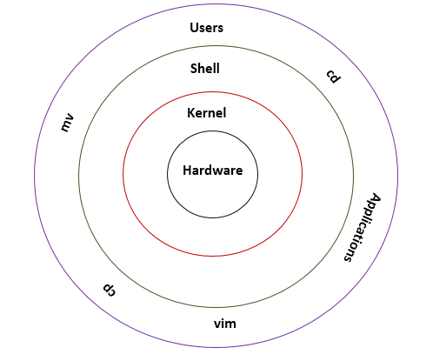
Device drivers: Device drivers are responsible for managing hardware devices such as disk drives, network cards, and printers.

